Slide 1
Inheritance in C++
Lesson #6
Note: CIS 601 notes were originally developed by H. Zhu for NJIT DL Program. The notes were subsequently revised by M. Deek.

Slide 2
Content
Base and Derived Classes
  Single Inheritance
  Declaration of derived classes
  Order of Constructor and Destructor Execution
  Inherited member accessibility
Multiple Inheritance
Virtual Base Classes

Slide 3
Base and Derived Classes
A base class is a previously defined class that is used to define new classes
A derived class inherits all the data and function members of a base class (in addition to its explicitly declared members.)

Slide 4
Single Inheritance
Implement an “is-a” relationship
The derived class only has one base class.

Slide 5
Example 1:
Student
name
id
major
Undergraduate
year
minor
etc.
Graduate
advisor
thesis
research
etc...

Slide 6
Example 2:
Publication:
publisher
date
Magazine:
# of issues per year
circulation
Book:
ISBN
author

Slide 7
Example: Publication
#include “FString.h"
class Publication {
public:
void SetPublisher( const FString & p )
{publisher.Assign(p);};
void SetDate( unsigned long dt )
{date = dt;};
FString GetPublisher(){return publisher;};
unsigned long GetDate(){return date;};
private:
FString publisher;
unsigned long date;
};

Slide 8
Publication
class Magazine :public Publication {
public:
void SetIssuesPerYear( unsigned n ){issuesPerYear=n;};
void SetCirculation( unsigned long n ){ circulation=n;};
unsigned GetIssuesPerYear(){return issuesPerYear;};
unsigned long GetCirculation(){return circulation;};
private:
unsigned issuesPerYear;
unsigned long circulation;
};

Slide 9
Publication
class Book :public Publication {
public:
void SetISBN( const FString & s )
{ISBN.Assign(s);};
void SetAuthor( const FString & s )
{author.Assign(s);};
FString GetISBN()
{return ISBN;};
FString GetAuthor()
{return author;};
private:
FString ISBN;
FString author;
};

Slide 10
Publication
int main()
{Book B;
B.SetPublisher( "Prentice Hall" );
B.SetDate( 970101L );
B.SetISBN( "0-02-359852-2" );
B.SetAuthor( "Irvine, Kip" );
cout << B.GetPublisher()<<endl
<<B.GetDate()<<endl
<<B.GetISBN().CString()<<endl
<<B.GetAuthor().CString()<<endl;
Magazine M;
M.SetIssuesPerYear( 12 );
M.SetCirculation( 500000L );
cout << M.GetIssuesPerYear()<<endl
<<M.GetCirculation()<<endl;
return 0;
}//ex6pub(Fstring.h, fstring.cpp, ex6pub.cpp)

Slide 11
Different Views of an Employee
Full-time or part-time
Permanent or Temporary
How do you define its base class? How td you define derived classes based on this base class?

Slide 12
Declaring Derived Classes
Class class_name: access_specifier_{opt} or base_class { Member_list
}
access_specifier ::= public|protected|private(default)
Equivalent to :
  Subclass ::=<Id, SupeId, Ds, Ops, Intfc>

Slide 13
3D Point
class Point {
public:
Point();
Point( int xv, int yv );
void SetX( int xv );
void SetY( int yv );
private:
int x;
int y;
};

Slide 14
3D Point
class Point3D :public Point {
public:
Point3D();
Point3D( int xv, int yv, int zv );
void SetZ( int zv );
private:
int z;
};

Slide 15
3D Point
Point3D::Point3D( int xv, int yv, int zv )
{ SetX( xv );
SetY( yv );
SetZ( zv );
}
int main()
{
Point3D P;
P.SetX( 100 );
P.SetY( 200 );
P.SetZ( 300 );
return 0;
}

Slide 16
Order of Constructor and Destructor Execution
Base class constructors are always executed first.
Destructors are executed in exactly the reverse order of constructors
The following example, shows you the ordering of constructors.

Slide 17
Example
Class Employee{
Public:
  Employee();
  //…
};
Class SalariedEmployee:public Employee{
Public:
  SalariedEmployee();
  //…
};
Class ManagementEmployee:public SalariedEmployee{
Public:
  ManagementEmployee();
  //…
};
ManagementEmployee M;

Slide 18
Example
2
Coordinate
Point
Shape
1
1
Point3D
Sphere

Slide 19
Example
#include <iostream.h>
class Coordinate {
public:
Coordinate() { cout << "Coordinate,"; }
~Coordinate() { cout << “~Coordinate,"; }
};
class Point {
public:
Point() { cout << "Point,"; }
~Point() { cout << “~Point,"; }
private:
Coordinate x;
Coordinate y;
};

Slide 20
Example
class Point3D :public Point {
public:
Point3D() { cout << "Point3D,"; }
~Point3D() { cout << “~Point3D,"; }
private:
Coordinate z;
};
class Shape {
public:
Shape() { cout << "Shape,"; }
~Shape() { cout << “~Shape,"; }
};

Slide 21
Example
class Sphere :public Shape {
public:
Sphere() { cout << "Sphere"; }
~Sphere() { cout << "Sphere"; }
private:
Point3D center;
unsigned radius;
};
int main()
{ Sphere S;
return 0;
} //See Ex6-1.cpp

Slide 22
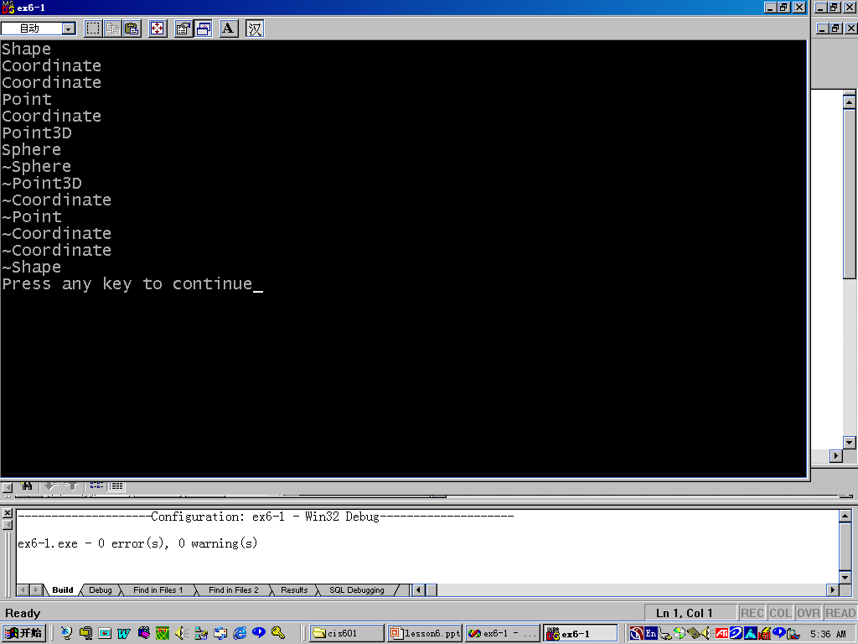

Slide 23
Overriding
A function in the derived class with the same function name will override the function’s variables in the base class.
You can still retrieve the overridden functions variables by using the scope resolution operator ”::”.

Slide 24
Overriding
#include <iostream.h>
#include <stdlib.h>
class A
{ int i;
public:
A(){i = 5;};
int get(){return i;};
};
class B: public A
{ int i;
public:
B(){i = 10;};
int get(){return i;};
};
void main()
{ B b;
int x;
cout << b.get()<<endl;
cout << b.A::get()<<endl;
cout << sizeof(x)<<endl;
cout << sizeof(b)<<endl;
}//ex7overriding.cpp

Slide 25
Types of Class Members
private
protected
public

Slide 26
Types of Class Members
Accessible to derived
classes and the instances
Public
Protected
Private
Accessible
to derived
classes only
?
not
accessible
Derived Class

Slide 27
Types of Inheritance
public
private
protected

Slide 28
Public Inheritance
Public and protected members of the base class become respectively public and protected members of the derived class.

Slide 29
Public
Protected
Private
public
Public
Protected
Private
Class
Functions(instances)

Slide 30
Example
#include <iostream.h>
#include <assert.h>
class Item {
  Item * ptr;
int data;
public:
Item(){data = 0; ptr = NULL;};
Item(int i){data = i; ptr = NULL;
cout <<"Item::Item"<<i <<endl;
};

Slide 31
Example
void setItem(int i){data = i;
cout <<"Item::setItem"<<i <<endl;
};
void setPtr(Item * i){ptr = i;
cout <<"Item::setPtr"<<endl;
};
int getData(){return data;};
Item * getPtr(){return ptr;};
};

Slide 32
Example
class List {
Item * head, *first, *last;
public:
List(){ head = NULL;
first = head;
last = head; }
Item * RemoveLast();
Item * RemoveFirst();
void PutFirst( Item * I );
void PutLast( Item * I );
protected:
int IsEmpty() const
{return (head==NULL);};
};

Slide 33
Example
Item * List::RemoveFirst()
{ Item * temp;
temp = first;
first = first -> getPtr();
cout <<"List:: RemoveFirst()"<<endl;
return temp;
};
Item * List::RemoveLast()
{ Item * temp;
temp = last;
last = last -> getPtr();
cout <<"List:: RemoveLast()"<<endl;
return temp;
};

Slide 34
Example
void List::PutFirst(Item * I)
{ I->setPtr(first);
first = I;
cout <<"List::PutFirst"<<I->getData() <<endl;
};
void List::PutLast(Item * I)
{ I->setPtr(last);
first = I;
};

Slide 35
Example
class Stack :public List {
public:
void Push( Item * I );
Item * Pop();
};
void Stack::Push( Item * I )
{PutFirst( I );
cout <<"Stack::Push"<<I->getData() <<endl;
}
Item * Stack::Pop()
{cout <<"Stack::Pop()"<<endl;
return RemoveFirst();
}

Slide 36
Example
int main()
{Item anItem(50), *p;
Stack aStack;
aStack.Push( &anItem );
p = aStack.Pop();
cout <<"aStack.Pop"<< p->getData()<<endl<<endl;
anItem.setItem(100);
aStack.Push( &anItem );
p = aStack.RemoveFirst();
cout <<"aStack.RemoveFirst"<< p->getData()<<endl<<endl;
return 0;
}//ex6-2.cpp

Slide 37
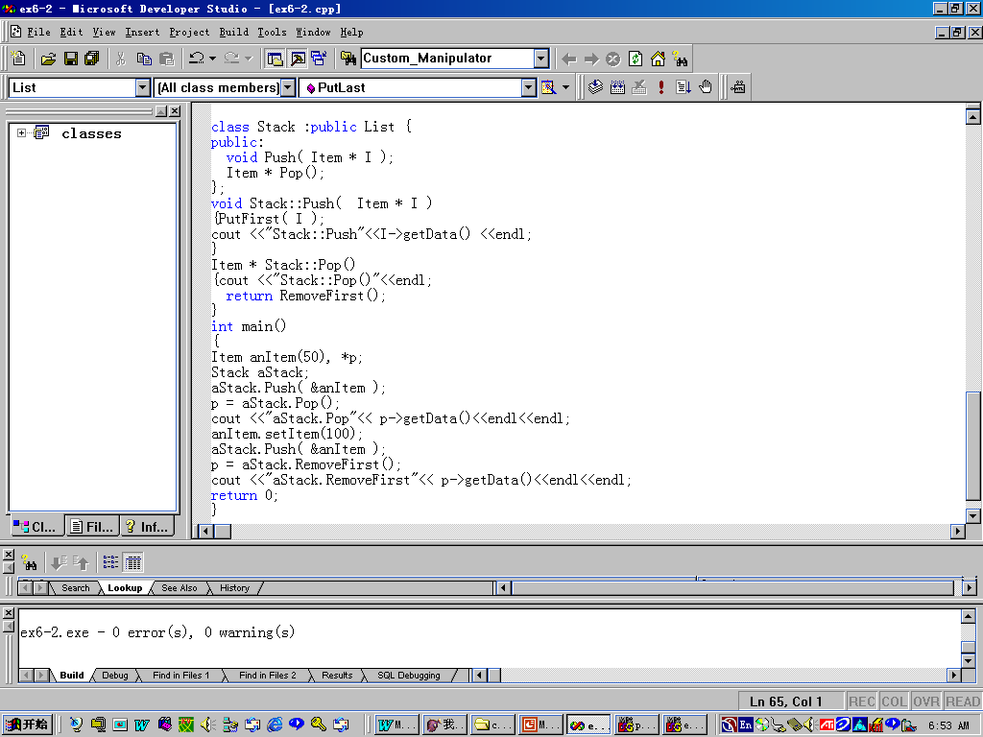

Slide 38
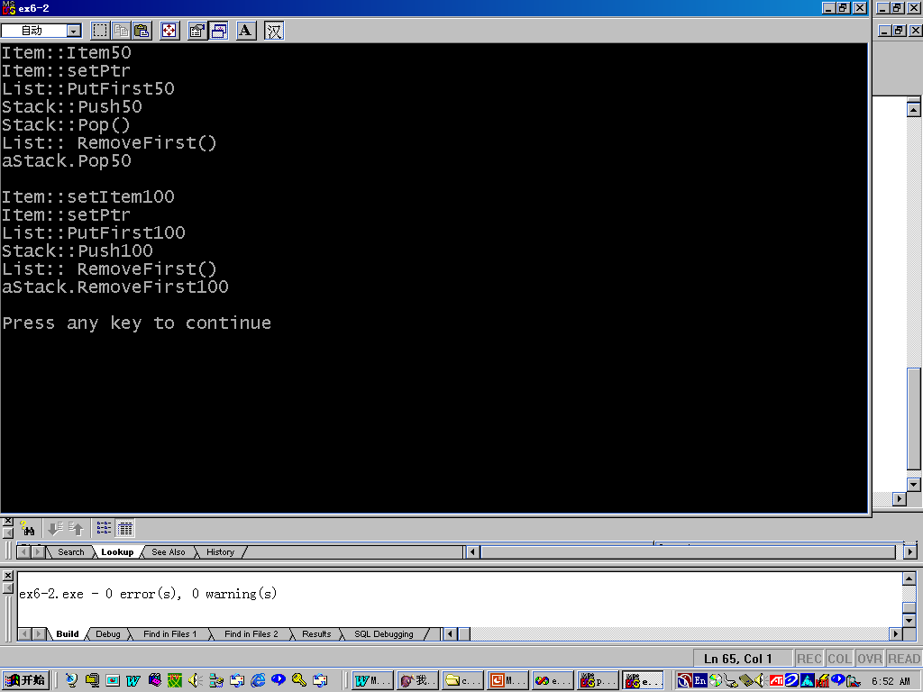

Slide 39
Private Inheritance
Public and protected members of the base class become private members of the derived class.

Slide 40
Public
Protected
Private
private
Public
Protected
Private
Function(instances)
Class

Slide 41
Example
class Queue :private List {
public:
void Enqueue( Item * I );
Item * Serve();
};
void Queue::Enqueue( Item * I )
{ List::PutFirst( I );
cout <<"Queue::Enqueue"<<I->getData() <<endl;
}
Item * Queue::Serve()
{cout <<"Queue::Serve"<<endl;
return List::RemoveFirst();
}

Slide 42
Example
int main()
{Item anItem(50), *p;
Queue aQueue;
anItem.setItem(60);
aQueue.Enqueue(&anItem);
p = aQueue.Serve();
cout <<"aQueue.Serve"<< p->getData()<<endl<<endl;
anItem.setItem(600);
aQueue.Enqueue(&anItem);
p =aQueue.RemoveFirst(); //Unaccessible
//cout <<"aQueue.RemoveFirst"<< p->getData()<<endl;
return 0;
}//ex6-3.cpp

Slide 43
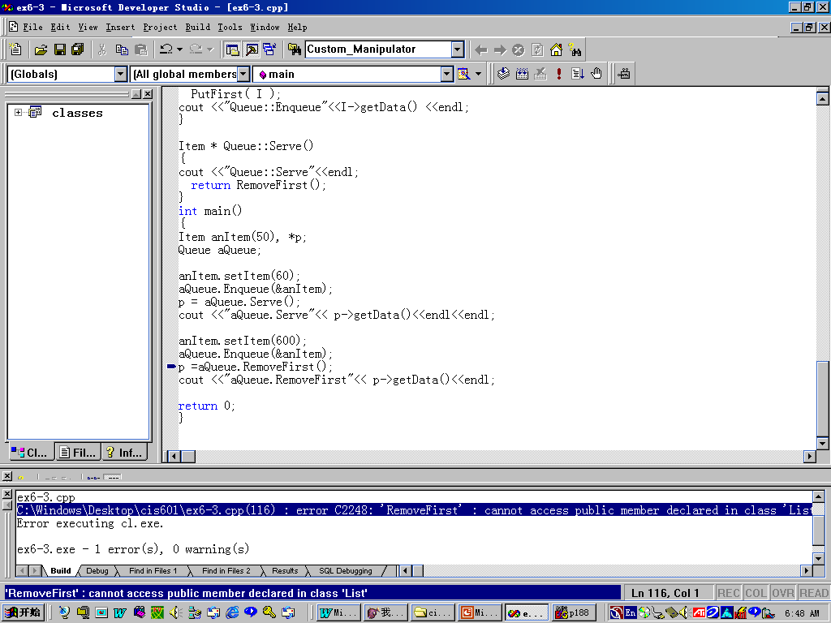

Slide 44
Protected Inheritance
Public and protected members of the base class become protected members of the derived class.

Slide 45
Public
Protected
Private
protected
Public
Protected
Private
Function(instances)
Class

Slide 46
Example
class Stack1 :protected List {
public:
void Push( Item * I );
Item * Pop();
};
void Stack1::Push( Item * I )
{PutFirst( I );
cout <<"Stack1::Push"<<I->getData() <<endl;
}
Item * Stack1::Pop()
{cout <<"Stack1::Pop()"<<endl;
return RemoveFirst();
}

Slide 47
Example
int main()
{Item anItem(50), *p;
Stack1 aStack1;
aStack1.Push( &anItem );
p = aStack1.Pop();
cout <<"aStack1.Pop"<< p->getData()<<endl<<endl;
anItem.setItem(100);
aStack1.Push( &anItem );
p = aStack1.RemoveFirst();//Unaccessible!
cout <<"aStack1.RemoveFirst"<< p->getData() <<endl<<endl;
return 0;
}

Slide 48
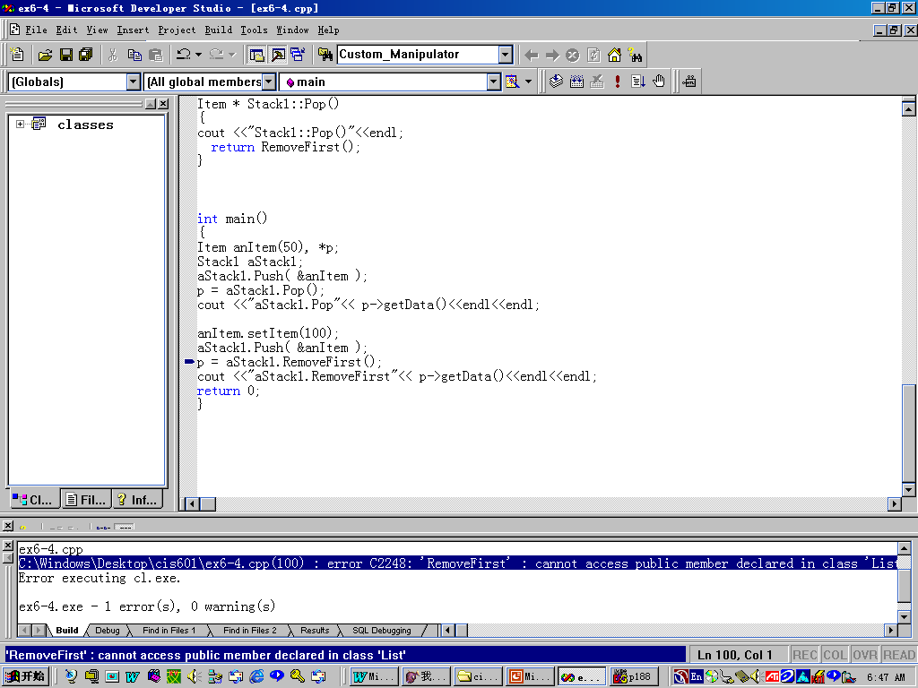

Slide 49
The accessibility of inherited members in a derived class
derived member | Public | Protected | Private
Public | X | X
Protected | X | X
Private

Slide 50
The accessibility of inherited members for an instance
derived
member
Public
Protected
Private
Public
X
Protected
Private

Slide 51
Constructor- Initializers
Point3D::Point3D(param-list): ctor-initializer
{// function body
}
ctor-initializer is actually used to transfer the parameters to the constructors of the base-class

Slide 52
Publication
#include <iostream.h>
#include <string.h>
class Date
{
public:
Date( int mo, int dy, int yr )
{
month = mo; day = dy; year = yr;
cout << "Date constructor\n";
}
// Ex6pub2.cpp

Slide 53
Publication
Date( Date & D )
{
month = D.month; day = D.day; year = D.year;
cout << "Date copy constructor\n";
}
~Date() { cout << "Date destructor\n"; }
private:
int year;
int month;
int day;
};

Slide 54
Publication
class Publication
{
public:
Publication( char * publshr, Date & aDate )
: pubDate( aDate )
{
strcpy( publisher, publshr);
cout << "Publication constructor\n";
}
~Publication()
{ cout << "Publication destructor\n"; }
private:
char publisher[30];
Date pubDate;
};

Slide 55
Publication
class Magazine :public Publication
{public:
Magazine( char * publshr, Date & aDate,
int issues ): Publication( publshr, aDate )
{issPYear = issues;
cout << "Magazine constructor\n";
}
~Magazine() { "Magazine destructor\n"; }
private:
int issPYear; // issues per year
};
int main()
{ Magazine aMag( "Zipp", Date(10, 1, 95), 12 );
return 0;
}

Slide 56
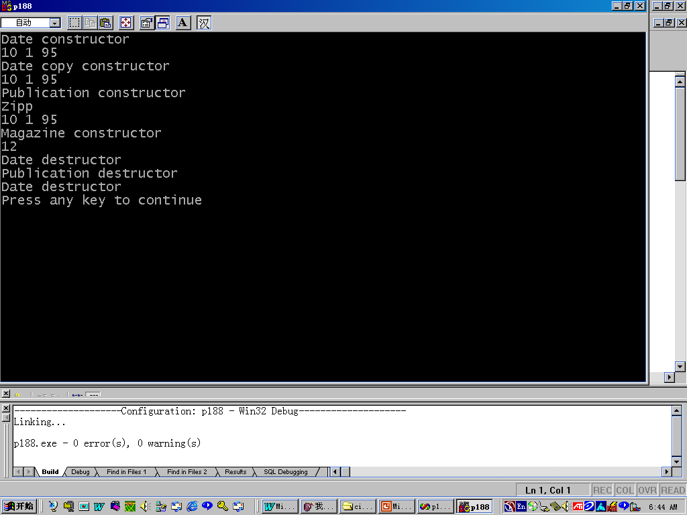

Slide 57
Why use the constructor-initializer?
Without it, the default constructor for the base class would be called, which would then have to be followed by calls to access functions to set specific data members.
A constructor initailizer is therefore more efficient.

Slide 58
Constructors in Derived Classes
When an object of a derived class is created, the constructor of the object must first explicitly call the constructor of the base class.
This is the same as constructor- initializer.

Slide 59
Destructor Function
Destructors are called implicitly starting with the last derived class and moving in the direction of the base class.

Slide 60
Compatibility Between Base and Derived Classes
An object of a derived class can be treated as an object of its base class.
The reverse is not true.

Slide 61
Nested Class Scope
A public or protected base class member that is hidden from the derived class can be accessed using the scope resolution operator ” ::”
For example: base-class::member
The “that” of base class can not access the members of its derived classes.

Slide 62
Example
Class Parent {
public:
void Print() const;
//…
}
class Child: public Parent {
public:
void Print() const{
Parent::print();// scope resolution !!!
cout <<age<<‘\n’
<<school<<‘\n’;
}
private;
int age;
Fstring school;
}

Slide 63
Error
Void Parent::Print() {
cout<<name <<‘\n’
<<Child::age <<‘\n’;
//base can not access that of derived
}

Slide 64
Implicit Conversion of Derived Pointers to Base Pointers
A base type pointer can point to either a base object or a derived object.
  Point3D center;// Point3D is derived from Point
  Point * p = &center;
  Point3D *cp = new Point3D;
  Point *p;
  p = cp;

Slide 65
Example
class FString { };
class Student {
public: //...
private:
long id;
};
class GraduateStudent :public Student {
public: //...
private:
FString thesisTitle;
};

Slide 66
Example
void CalcTuition( Student & sp )
{ /* sp is a Student or a derived object */}
void RecordThesis( GraduateStudent * p )
{ /*... */ }
int main()
{Student * sp;
GraduateStudent * gp; //...
sp = gp; //...
RecordThesis( (GraduateStudent *) sp );
return 0;
}

Slide 67
Casting Base Pointers to Derived Pointers
A base pointer can not be implicitly converted to a derived pointer.
This conversion is risky, because the derived object can contain more than the base object.

Slide 68
Example
void DoSomething(const GraduateStudent * GS)
{ cout << GS->GetThesisTitle();}
Student * sp = new Student;
DoSomething(sp);
DoSomething(GraduateStudent (sp));
Student * sp = new GraduateStudent;
DoSomething(GraduateStudent (sp));
//Error

Slide 69
Example
class Item {/* …*/}
class Student: public Item{/* …*/}
class Collection {
public:
void Append (const Item * ip);
Item * Get() const; }
const unsigned Count = 10;
Collection studentList;
Student * p;
for (int i=0; i<Count; i++ )
{p = new Student;
studentList.Append(p);}
p = (student*) studentList.Get();//explicit cast

Slide 70
Attention
Forcing class users to use explicit casting often leads poor code.
class studentCollection:public Collection{
public:
student * Get() const
{ return (student *) Collection::Get(); }
//…
}
studentCollection studentList;
student *p;
//…
p = studentList.Get(); // no cast required

Slide 71
Multiple Inheritance
employee
Student
salaried
GraduateAssistant

Slide 72
Example
#include <iostream.h>
#include "fstring.h"
typedef unsigned long ulong;
class Student {
public:
unsigned GetAge() const;
ulong GetId() const;
unsigned GetMajor() const;
void SetAge( unsigned n );
void SetId( ulong n );
void SetMajor( unsigned n );
private:
ulong id;
unsigned majorCode;
unsigned degreeCode;
float gpa;
unsigned age;
};

Slide 73
Example
class Employee {
public:
unsigned GetAge() const;
const FString & GetBenefits() const;
unsigned GetExemptions() const;
void SetAge( unsigned n );
void SetBenefits( const FString & benef );
void SetExemptions( unsigned n );
private:
unsigned age;
unsigned exemptions;
FString benefits;
};

Slide 74
Example
class Salaried :public Employee {
public:
float GetSalary() const;
void SetSalary( float s );
private:
float salary;
};
class GradAssistant :public Student, public Salaried {
public:
void Display() const;
};

Slide 75
Example
void GradAssistant::Display() const
{ cout << GetId() << ','
<< GetMajor() << ','
<< GetSalary() << ','
<< GetExemptions() << endl;
}
int main()
{ GradAssistant GA;
GA.SetId(12345);
// GA.SetAge(22); // error: ambiguous
GA.Student::SetAge(22); // ok - specific
GA.SetMajor(108);
GA.SetExemptions(2);
GA.SetSalary(10000);
GA.Display();
return 0;
}//ex6mulin.cpp

Slide 76
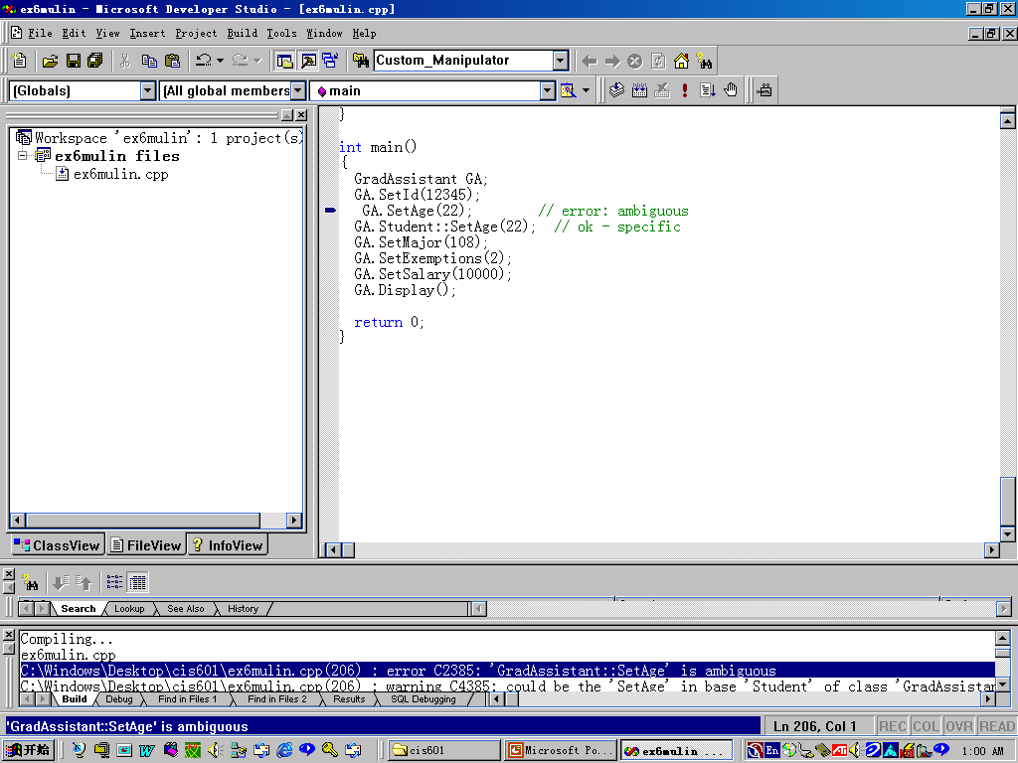

Slide 77
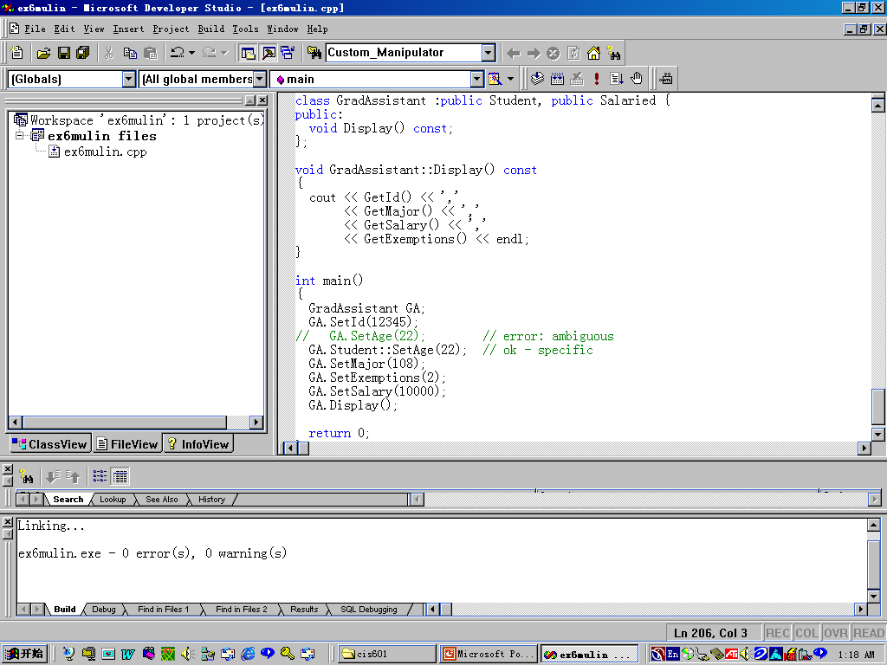

Slide 78
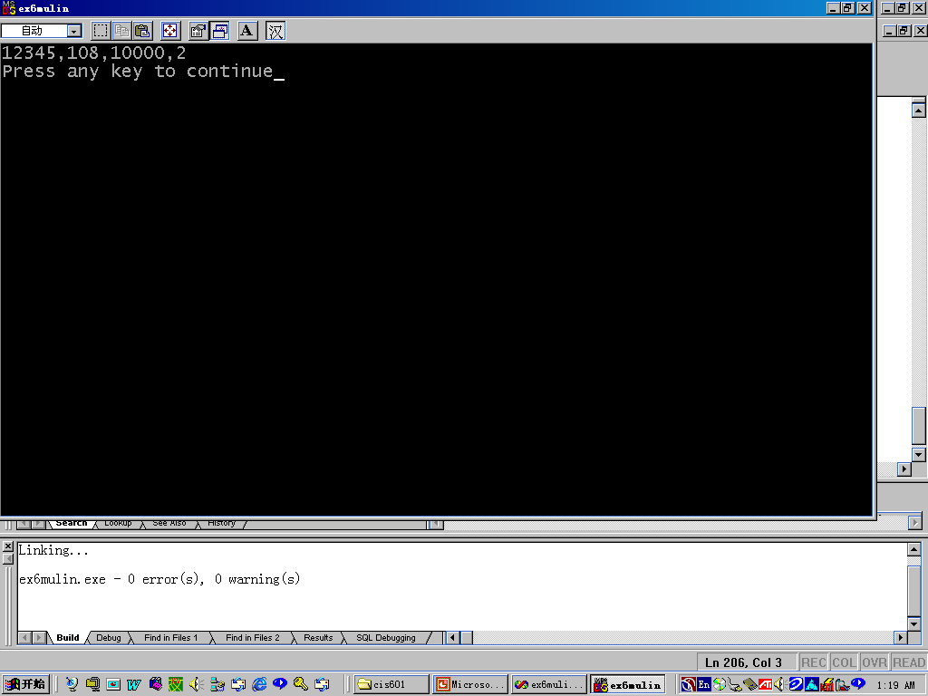

Slide 79
Example
Question:
If we want to set a GradAssistant ‘s age by calling SetAge(), which SetAge() should we use use?
  Direct solution: Student::SetAge() or Salaried::SetAge().
  Abstract(Virtual) base classes

Slide 80
Virtual base classes
Person
employee
Student
salaried
Graduate Assistant

Slide 81
Example
#include <iostream.h>
#include "fstring.h"
typedef unsigned long ulong;
class Person {
public:
unsigned GetAge() const;
const FString & GetSocSecNum() const;
void SetAge( unsigned n );
void SetSocSecNum( const FString & ssn );
private:
unsigned age;
FString socSecNum;
};

Slide 82
Example
class Student :public virtual Person {
public:
unsigned GetMajor() const;
void SetMajor( unsigned n );
private:
unsigned majorCode;
unsigned degreeCode;
float gpa;
};

Slide 83
Example
class Employee :public virtual Person {
public:
const FString & GetBenefits() const;
unsigned GetExemptions() const;
void SetBenefits( const FString & benef );
void SetExemptions( unsigned n );
private:
unsigned exemptions;
FString benefits;
};

Slide 84
Example
class Salaried :public Employee {
public:
float GetSalary() const;
void SetSalary( float s );
private:
float salary;
};
class GradAssistant :public Student, public Salaried {
public:
void Display() const;
};

Slide 85
Example
void GradAssistant::Display() const
{ cout << GetSocSecNum() << ','
<< GetAge() << ',‘
// ambiguous if not virtual
}
int main()
{ GradAssistant GA;
return 0;
}

Slide 86
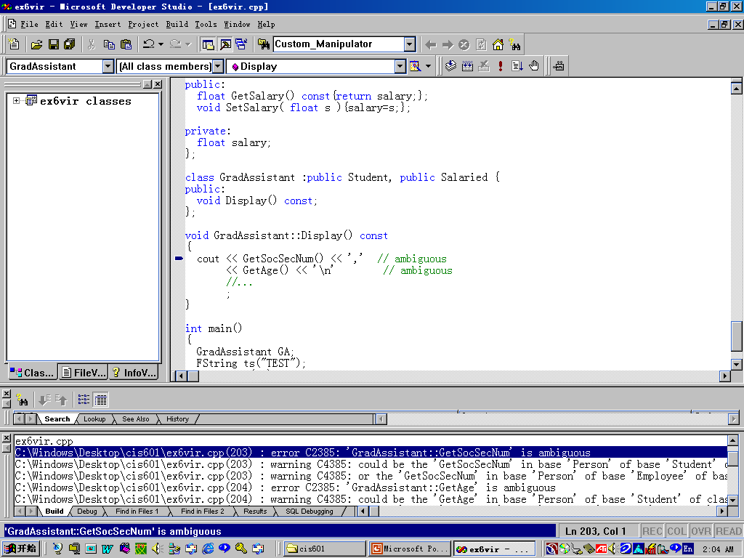

Slide 87
Virtual Base Classes
The function calls in GradAssistant::Display() are ambiguous unless Person is inherited as a virtual base class.
Adding “virtual” lets the compiler decide which function and which variable should be accessed.

Slide 88
Virtual Base Classes
Person(22)
Employee(22)
Student(8)
Salaried(4)
GraduateAssistant(0)
aGA(78)

Slide 89
Virtual Base Classes(end)
Person(22)
virtual
virtual
Employee(22)
Student(8)
Salaried(4)
GraduateAssistant(0)
aGA(56)

Slide 90
Readings
Readings
  Chapter 6 Sections 6.1.3 – 6.5

